Slide 2
6 x 4 and 4 x 6 ratio
1
2

Slide 3
6 x 4 and 4 x 6 ratio
3
4

Slide 4
6 x 4 and 4 x 6 ratio
5
6

Slide 5
6 x 4 and 4 x 6 ratio
7
8

Slide 6
6m x 6ft
9

Slide 7
4 x 1 ratio
10
Apterra HP / Aspire 4G / Alnac 4G

Slide 8
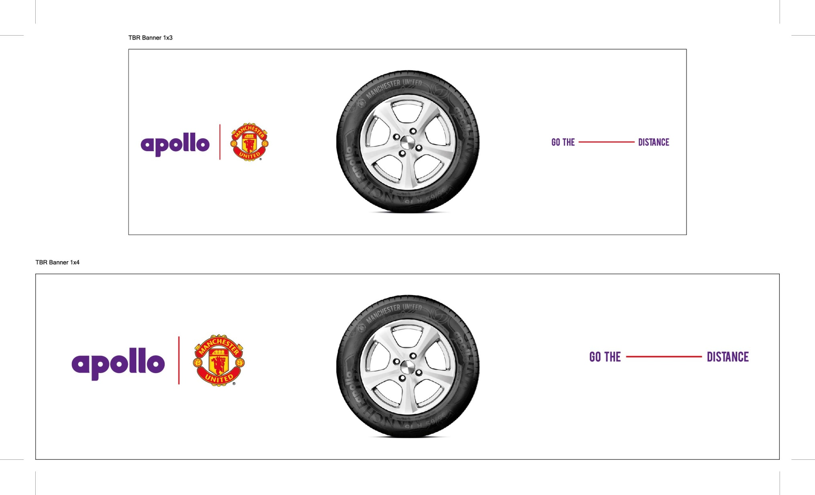
3 x 1 and 4 x 1 (ManU tyre)
11
12

Slide 9
16ft x 3.3ft
13

Slide 10
3 x 1 and 4 x 1 ratio
14
15

Slide 11
3 x 1 and 4 x 1 ratio
16
17

Slide 12
3 x 1 and 4 x 1 ratio
18
19

Slide 13
Thank You

